Slide 1
Lecture 3:
1.2. Theory: The Malthus-Solow Economic Growth Model
Brad DeLong
Department of Economics and Blum Center, U.C. Berkeley; WCEG; and NBER
last revised: 2020-01–12
Original course by Melissa Dell (Harvard Econ 1342), revised by Brad DeLong, research assistance by Anish Biligiri
<>

Slide 2
Lecture Outline
Read Beforehand: J. Bradford DeLong: Lecture Notes: Malthusian Economies <https://tinyurl.com/dl-2020-01-18g>
Read Beforehand: Greg Clark: A Farewell to Alms, selections <https://delong.typepad.com/files/clark-alms-selections.pdf>
Slides: <https://github.com/braddelong/public-files/blob/master/econ-135-lecture-3.pptx>
Review: Long-run shape of global economic growth
Lecture: Solow-Malthus model basics
Review: Solow model essentials
Lecture: Applying the Solow-Malthus model
<https://datahub.berkeley.edu/user/delong@econ.berkeley.edu/notebooks/LS2019/2019-10-14-Ancient_Economies.ipynb>
<https://nbviewer.jupyter.org/github/braddelong/LS2019/blob/master/2019-10-14-Ancient_Economies.ipynb>
Assignment: What is economics? paper <https://bcourses.berkeley.edu/courses/1487685/assignments/8065184>
Big Ideas: Principal takeaways from this class
MOAR references:
C.I. Jones: The Facts of Economic Growth <https://web.stanford.edu/~chadj/facts.pdf>...
Gregory Clark (2005): The Condition of the Working Class in England, 1209-2003 <https://delong.typepad.com/files/clark-condition.pdf>...
Ian Morris (2010): Why the West Rules–For Now, chapter 3: Taking the Measure of the Past <https://delong.typepad.com/files/morris-rules-3.pdf>...
Patricia Crone: Pre-Industrial Societies, selections <https://delong.typepad.com/files/crone-pre-selections.pdf>...

Slide 3
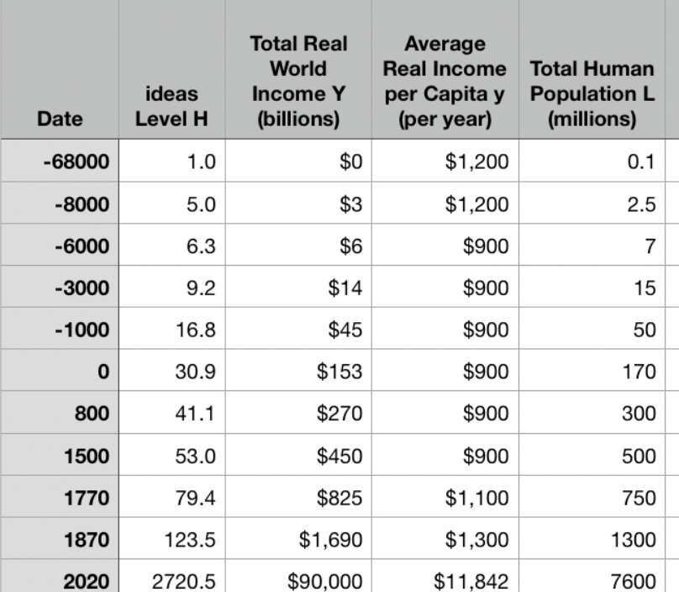
Changeup Review: One Table: Average Global Numbers
J. Bradford DeLong brad.delong@gmail.com 2020-01-18 <https://www.icloud.com/keynote/0SdT7FNHq2y3FcaD2KU9zRrxg>

Slide 4
You’ve Seen This Before…
Approximately what was the growth rate of the human useful-ideas stock between the year 0 and 1500?
About 0.036%/year
About 3.6%/year
About 2.06%/year
About 0.206%/year
None of the above are close

Slide 5
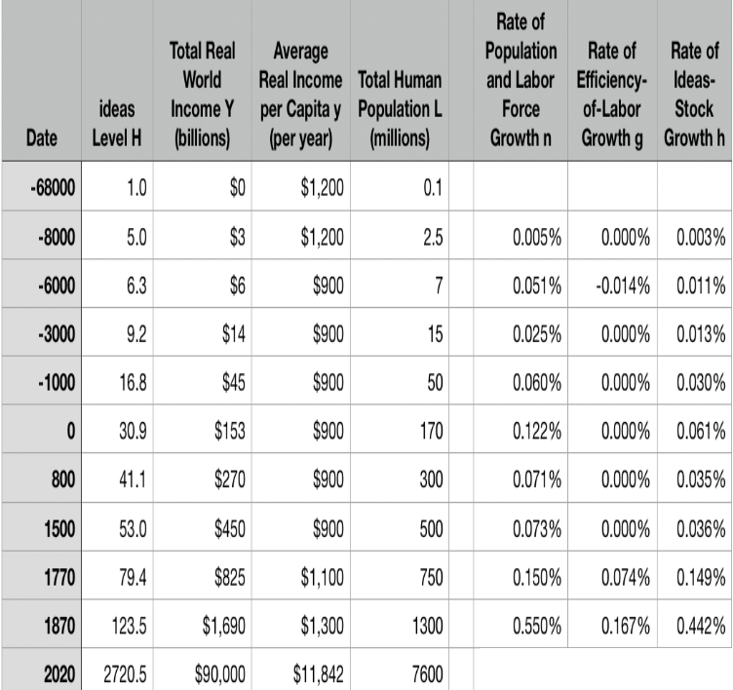
One Table: Average Global Numbers
Approximately what has been the growth rate of the human useful-ideas stock between the year 1870 and today?
About 0.036%/year
About 3.6%/year
About 2.06%/year
About 0.206%/year
None of the above are close

Slide 6

Why Is This Interesting?
2.06/.0036 is about 60, no?
What else do you find interesting about this table to the left?

Slide 7

One Table: Average Global Numbers
10:00

Slide 8
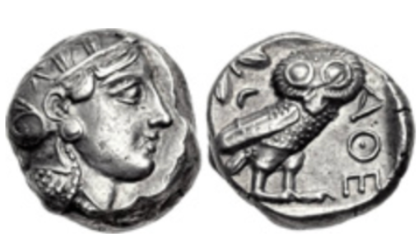
Questions
What assumption that Aristotle made—perhaps (probably?) without thinking about it, because it seemed most obvious to him—struck you as the most wrong or repugnant or weird?
What role do the “statues of Daedalus, [and] the tripods [robotic catering vessels] of Hephaestus” play in Aristotle’s argument about how the economy of his age is, must be, and should be structured?
What role does Aristotle’s claim that “Of the art of acquisition [ktêtike] then there is one kind which by nature is a part of the management of a household…. There is another… commonly and rightly called an art of wealth-getting [chrêmatistikê]… [with] the notion that riches and property have no limit…” play in his argument?
Did you find any advice—even indirect and oblique advice—from Aristotle in this passage about what the economic policy of a city-state should be? If so, what was it? If not, why do you think he fails to offer advice here (he offers lots of advice as to the organization and policies of city-states later on in the book)?
What does Aristotle say are the four tasks of the Greek man in managing his household? Why these four?
What are these four in rank order of importance
Classical Athenian 4-drachma silver coin
The “owl”, with the head of the goddess Athene on the front and her familiar bird of wisdom on the back, of the type that Aristotle (or his slaves) would have carried on their person. Weighs 3/5 of an ounce. The Athenian navy paid its oarsmen one drachma a day.
J. Bradford DeLong brad.delong@gmail.com 2020-01-06

Slide 9

One Figure: A Great Divergence
10:20
From 1800 to 2018:
The dots start with a 3-1 spread in incomes and a 10-year spread in life expectancy.
All the arrows go up.
Some arrows—mostly those already to the right—go right fast.
Other arrows go right slowly.

Slide 10

China and India and America, 1800-1975
From 1800 to 1975:
Measured living standards and productivity levels improve fourteen-fold in the United States…
…& less than 30% in China & India…
…in spite of economic, transport, and cultural globalization…
This is crazy!
A “great divergence”
Not only were China & India relatively poor in 1800, they fell further behind thereafter

Slide 11

China and India and America, 1975–2018
From 1975-2018:
Measured living standards and productivity levels…
…54.9/25.9 = 2.12 in America…
…16.0/0.9 = 17.8 in China…
…6.9/1.2 = 5.8 in India…

Slide 12
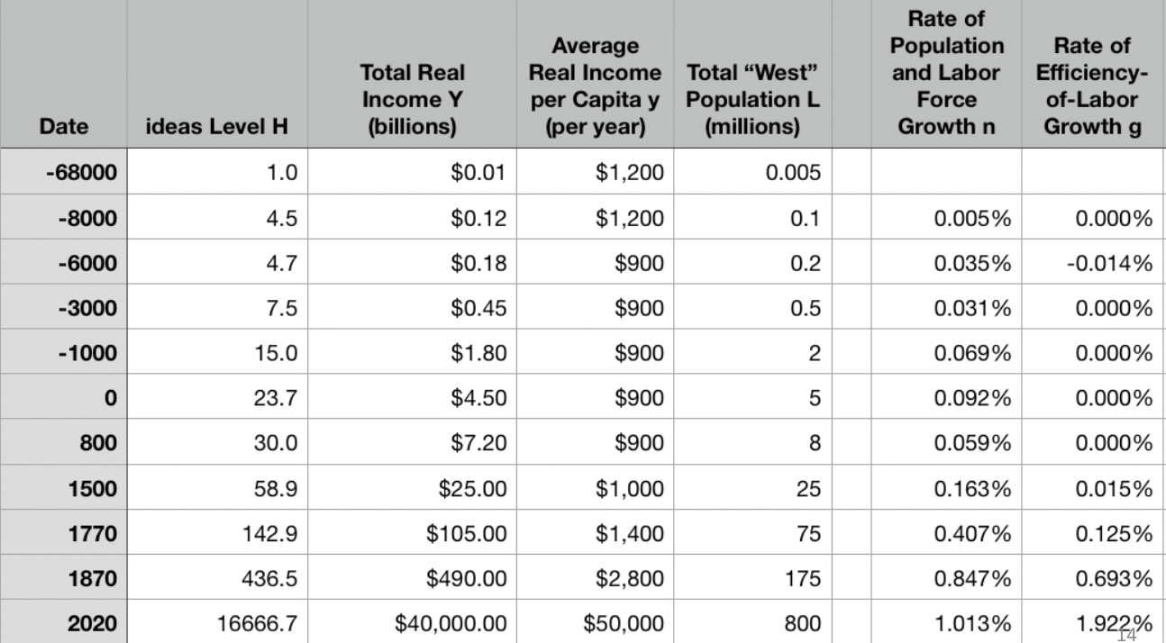
A Second Table: “The West”
10:45

Slide 13
Four Major Features
10:55
The history of economic growth has four major features:
Poverty, in the pre-industrial ages, with population growth on average but with average population growth very slow
n = 0.07%/yr; h = 0.035%/yr
Growing prosperity, in the Industrial Revolution and the Modern Economic Growth ages
In the MEG era: h = 2.06%/yr
The great divergence
Globalization
American twentieth-century economic ascendancy
Pre-industrial efflorescences and declines

Slide 14

Catch Our Breath…
Ask a couple of questions?
Make a couple of comments?
Any more readings to recommend?

Slide 15
Solow-Malthus Model Basics
How do we make sense of the fact that people were ingenious and inventive back before 1500, and yet standards of living did not increase?
Although population did increase—slowly
Other parts of the model
Balanced-growth equilibrium
Convergence to equilibrium
Lecture notes: <https://nbviewer.jupyter.org/github/braddelong/long-form-drafts/blob/master/solow-model-5-pre-industrial.ipynb>
datahub: <http://datahub.berkeley.edu/user-redirect/interact?account=braddelong&repo=long-form-drafts&branch=master&path=solow-model-5-pre-industrial.ipynb>

Slide 16
Solow-Malthus Model Basics: Efficiency of Labor
How do we make sense of the fact that people were ingenious and inventive back before 1500, and yet standards of living did not increase?
We first need to make efficiency of labor a function of available natural resources per worker.
We do this by setting the rate of efficiency of labor growth g = h - n/γ: equal to the rate h at which the stock of useful ideas grows and the rate of rate of growth of the labor force growth n divided by a resource-importance parameter γ.
Thus g = 0 if and only if: n = n^{*mal} = hγ.
What could make this happen?

Slide 17
Solow-Malthus Model Basics: Population and Labor-Force Growth
Back before 1500—and even later—people are anxious to have children:
In the hope that some of them will survive to themselves reproduce.
In a world without reliable and effective family planning mechanisms.
Let’s say:
1/Φ is the fraction of production devoted to necessities
y^{sub} is the “subsistence” standard of necessities consumption at which population growth averages zero:
Depends on sociology—marriage ages, &c….
Then, back before the demographic transition:
n = β(y/(Φy^{sub}) - 1)

Slide 18
Malthusian Equilibrium: Living Standards
Population and the labor force are growing just fast enough to soak up the benefits of new useful ideas:
hγ = n^{*mal} = β(y/(Φy^{sub}) - 1) In a world without reliable and effective family planning mechanisms.
This gives us: y^{*mal} = Φy^{sub}(1+ hγ/β).
Productivity levels and standards of living will be high enough that necessities consumption allows for enough population growth to soak up the (slow) rate of ideas generation.
Productivity levels and standards of living will be above subsistence—but not that far above subsistence

Slide 19
Malthusian Equilibrium: Population and Labor Force Growth
How big will the population and labor force then be?:
It needs to be at the level that preserves the Malthusian equilibrium:
Generates y^{*mal} = Φy^{sub}(1+ hγ/β)
y^{*mal} = (s/(n+g+δ))^{θ}E
And we know that in Malthusian equilibrium, g=0 and n = hγ
So: y^{*mal} = (s/(hγ+δ))^{θ}E
E = HL^{-(1/γ)}

Slide 20
Malthusian Equilibrium: Population and Labor Force Growth II
The master equations are then:
Φy^{sub}(1+ hγ/β) = y^{*mal} = (s/(hγ+δ))^{θ}HL^{-(1/γ)}
L^{*mal} = {[(H/y^{sub})(s/δ)^{θ}(1/Φ)]^{γ}} [1+hγ/δ]^{-γθ} [1+hγ/β]^{-γ}
How do we understand this?:
Two nuisance terms:
Population will be lower if population response is smaller, the resource scarcity drag is lower, or ideas generation is faster in order to generate the wedge in living standards above subsistence needed to get enough population growth to soak up the benefits of new ideas
Population will be lower if ideas generation is faster or the resource scarcity drag is lower because those will lower the economy’s steady-state capital intensity, and make it less productive

Slide 21
Malthusian Equilibrium: Population and Labor Force Growth III
The master equations are then:
Φy^{sub}(1+ hγ/β) = y^{*mal} = (s/(hγ+δ))^{θ}HL^{-(1/γ)}
L^{*mal} = {[(H/y^{sub})(s/δ)^{θ}(1/Φ)]^{γ}} [1+hγ/δ]^{-γθ} [1+hγ/β]^{-γ}
Three significant terms:
The ratio (H/y^{sub}) of ideas to subsistence necessities consumption
The ratio (s/δ)^{θ} of savings and investment to depreciation raised to the parameter θ
(1/Φ): the greater the taste for “luxuries”, the lower the population
And living in cities is perhaps the most important of the luxuries
All these are then magnified by the parameter γ in their effect on population

Slide 22
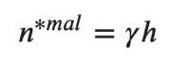
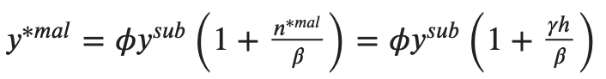
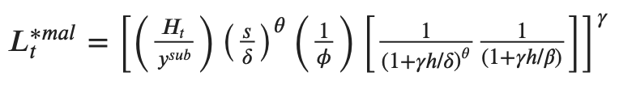
Understanding Malthusian Equilibrium
Interpretation
Start with the rate ℎ of new economically-useful ideas
Add on the resource-scarcity parameter 𝛾
From those derive the Malthusian population growth rate 𝑛^{∗𝑚𝑎𝑙} = 𝛾ℎ
Then derive the Malthusian standard of living y^{*mal}
Then derive the Malthusian population and labor force Lt^{*mal}

Slide 23
Dynamics?
Both population adjustment and the adjustment of the capital stock happen at about the same rate:
What if Lt < Lt^{*mal} and so y > y^{*mal}?
Population growth n is high…
So E declines…
And thus y falls—how fast depends on β/γ…
Complications to dynamics as κ falls and then rises…
<https://nbviewer.jupyter.org/github/braddelong/LS2019/blob/master/2019-09-06-210a-ancient-intro.ipynb>
<https://github/braddelong/LS2019/blob/master/2019-09-06-210a-ancient-intro.ipynb>
<https://github.com/braddelong/LS2019/blob/master/2019-08-17-Ancient_Economies.ipynb>
<https://github.com/braddelong/long-form-drafts/blob/master/malthusian_convergence.ipynb>

Slide 24
Changeup Review: Solow Model Essentials
Lecture Notes: <https://www.bradford-delong.com/2020/01/lecture-notes-the-solow-growth-model-the-history-of-economic-growth-econ-135.html>
Let's assume three things about the relationship between an economy's resources and the total output it produces and income it generates:
A proportional increase in the economy's capital intensity κ, measured by the capital stock divided by total production κ = K/Y, will carry with it the same (smaller) proportional increase in income and production Y no matter how rich and productive the economy is. A 1% increase in capital intensity will always increase income and production by the same proportional amount θ.
If two economies have the same capital intensity, defined as the same capital-output ratio κ, and have the same level of technology- and organization-driven efficiency-of-labor E, then the ratio of their levels of income and output will be equal to the ratio of their labor forces L.
If two economies have the same capital intensity, defined as the same capital-output ratio κ, and have the same labor forces L, then the ratio of their levels of income and output will be equal to the ratio of their technology- and organization-driven efficiencies-of-labor E

Slide 25

Solow Model Basics: Notes
The code in the nbViewer documents is static. But you should also look at:
<http://datahub.berkeley.edu/user-redirect/interact?account=braddelong&repo=long-form-drafts&branch=master&path=solow-model-2-basics.ipynb>
<http://datahub.berkeley.edu/user-redirect/interact?account=braddelong&repo=long-form-drafts&branch=master&path=solow-model-3-growing.ipynb>
<http://datahub.berkeley.edu/user-redirect/interact?account=braddelong&repo=long-form-drafts&branch=master&path=solow-model-4-using.ipynb>

Slide 26



The Rest of the Model: Growth Rates
Variables change over time:
growth of labor gL: proportional at a constant n (for now)
growth of labor efficiency gE: proportional at a constant g (for now)
rate of change of capital: savings minus depreciation
growth of capital gK = s/κ-δ
What do these mean?
Now let’s look at the rate of change of capital-intensity κ as a function of the level of capital-intensity κ, for constant n, g, s, δ, and θ…

Slide 27

Solving the Model

Slide 28

Balanced-Growth Equilibrium: Steady-State Capital-Intensity κ*

Slide 29

Along the Balanced-Growth Path
Everything except κ—which is constant—grows at a constant proportional rate: either n, or g, or n+g;
Labor force L grows at n
Income per worker y and the efficiency of labor E grow at g
Total income Y and the capital stock K grow at n+g

Slide 30

Convergence to Steady-State Capital-Intensity

Slide 31

Catch Our Breath…
Ask a couple of questions?
Make a couple of comments?
Any more readings to recommend?

Slide 32
Solow-Malthus Model Application
How do we make sense of the fact that people were ingenious and inventive back before 1500, and yet standards of living did not increase?
Yet we also had “efflorescences”
Yet efflorescences are then followed by declines—not by leveling-up elsewhere
The Iron Age dark age
The fall of the Roman Empire (and of the Han dynasty)
Babylon:
Baghdad
The Maya
The Black Death, and the conquistadores and their diseases…

Slide 33

Babylon, “The Gate of the Gods”: Owls and Satyrs and Wild Beasts and Dragons
Isaiah 13:
“The burden of Babylon, which Isaiah the son of Amoz did see….
“Babylon, the glory of kingdoms, the beauty of the Chaldees' excellency, shall be as when God overthrew Sodom and Gomorrah. It shall never be inhabited, neither shall it be dwelt in from generation to generation: neither shall the Arabian pitch tent there; neither shall the shepherds make their fold there. But wild beasts of the desert shall lie there; and their houses shall be full of doleful creatures; and owls shall dwell there, and satyrs shall dance there.
“And the wild beasts of the islands shall cry in their desolate houses, and dragons in their pleasant palaces: and her time is near to come, and her days shall not be prolonged…”

Slide 34

Understanding the Solow-Mathus Equilibrium: Prosperity
Notes:

Slide 35

Understanding the Solow-Malthus Equilibrium: Population and Labor Force
Notes:

Slide 36
How Does This System React to Shocks?
Let’s think of some:
a sudden major plague...
the rise of a civilization that carries with it norms of property and law and commerce, and thus a rise in 𝑠
the rise of an empire that raises s via the imperial peace and that also creates a rise in the taste for luxuries 𝜙 (and possibly reduces biological subsistence 𝑦^{𝑠𝑢𝑏})
a shift in the rate of ideas growth h...
a shift in sociology that alters subsistence 𝑦^{𝑠𝑢𝑏}…

Slide 37
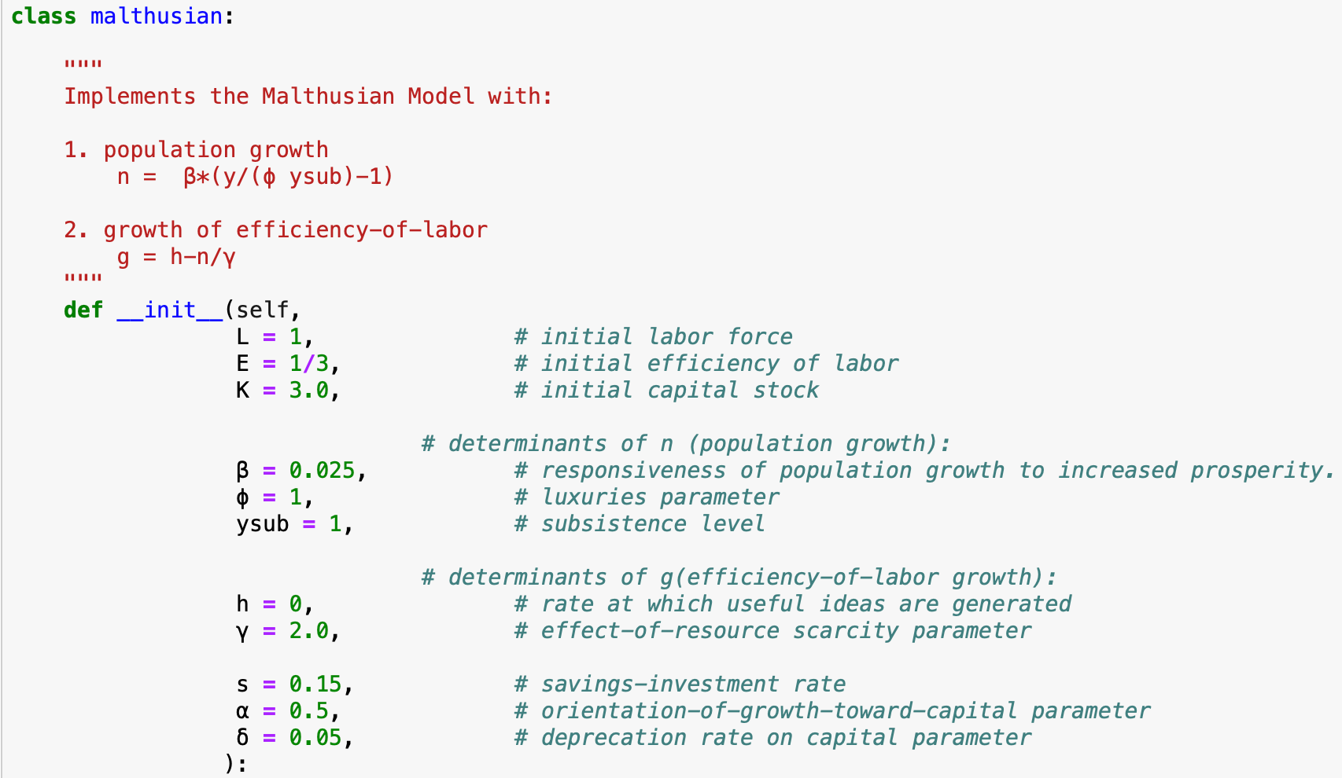

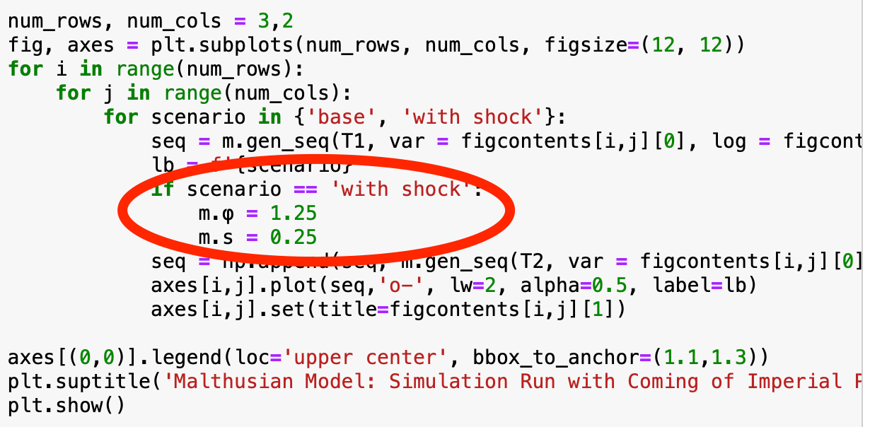
“class malthusian”
Files:
<https://nbviewer.jupyter.org/github/braddelong/LS2019/blob/master/2019-10-14-Ancient_Economies.ipynb>
<http://datahub.berkeley.edu/user-redirect/interact?account=braddelong&repo=LS2019&branch=master&path=2019-10-14-Ancient_Economies.ipynb>
What happens to parameters with…
…a sudden major plague: L↓ (and κ↓ too)
…the rise of a civilization that carries with it norms of property and law and commerce: s↑
…the rise of an empire that brings both civilization in the form of an imperial peace, and that also creates a taste for luxuries: s↑, 𝜙↑, (and possibly 𝑦^{𝑠𝑢𝑏}↓ as well)
…a shift in the rate of ideas growth: h↑
…a shift in sociology that alters subsistence: 𝑦^{𝑠𝑢𝑏}↑ or ↓

Slide 38

Steady-State and Along the Transition Path
The fall of an empire:
<https://nbviewer.jupyter.org/github/braddelong/LS2019/blob/master/2019-10-14-Ancient_Economies.ipynb>
A decline in inequality, taste for luxuries, and taste for urban living: Δφ = -0.25
A decline in law-and-order that produces a sharp fall in the savings rate: Δs = -0.10

Slide 39
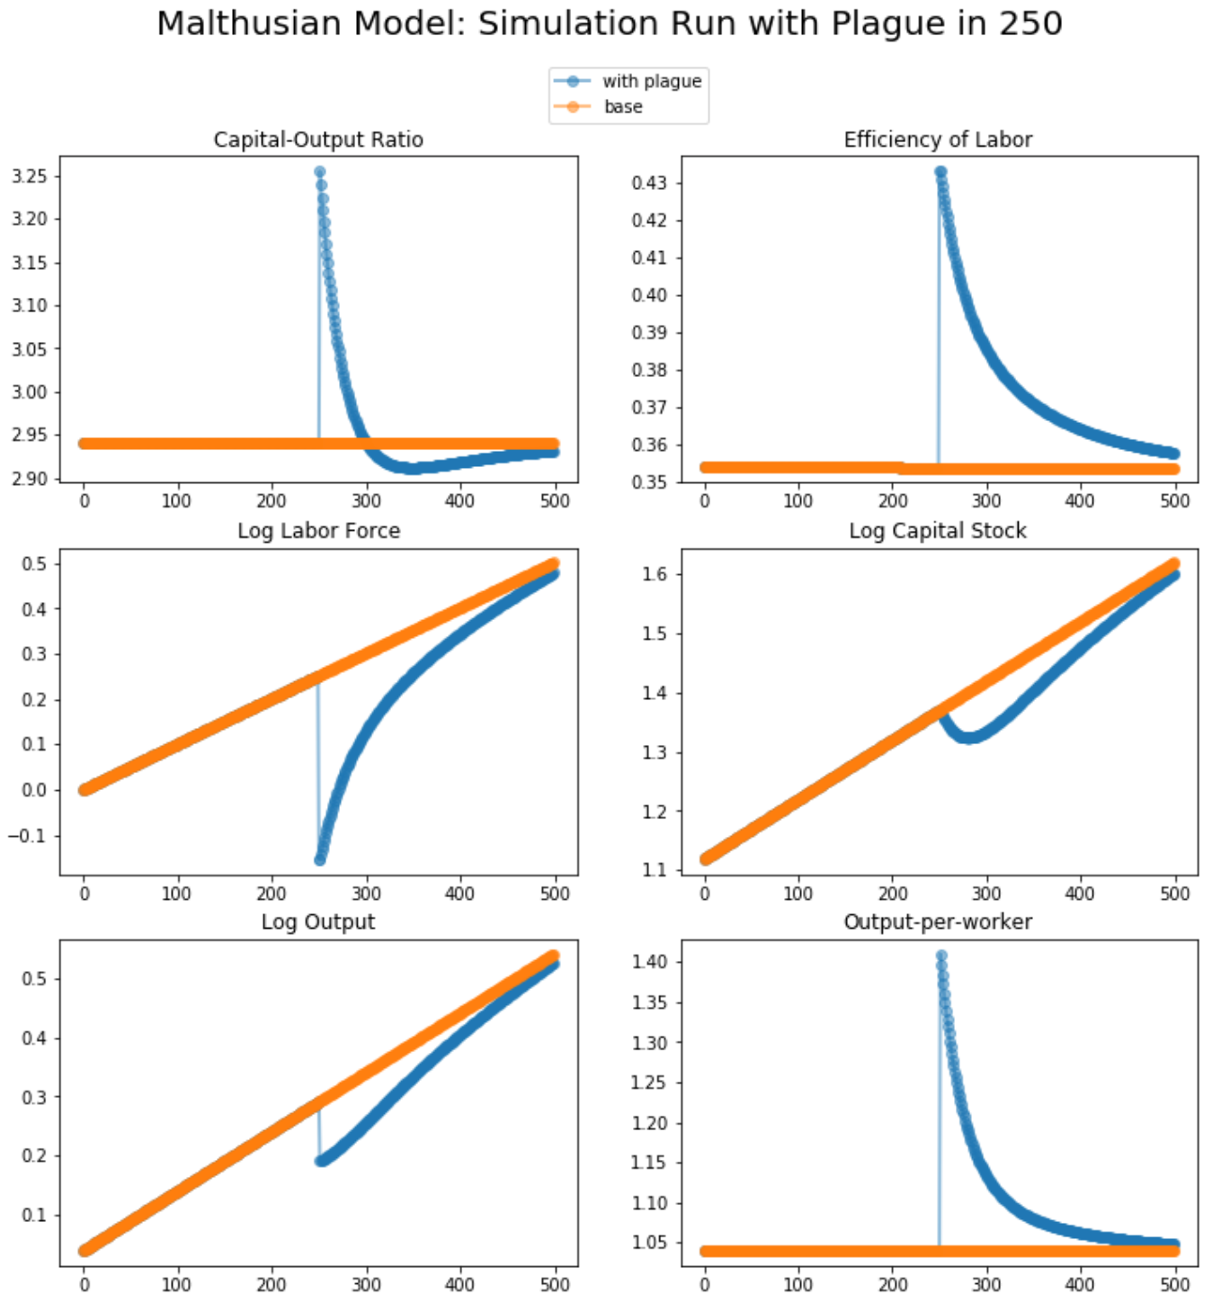
Steady-State and Along the Transition Path II
A civilization-wide great plague:
<https://nbviewer.jupyter.org/github/braddelong/LS2019/blob/master/2019-10-14-Ancient_Economies.ipynb>
A third of the population is carried off: ΔL = -0.33

Slide 40
Assignment: Malthusian Economies Paper
200-300 words; due Feb 1; <https://bcourses.berkeley.edu/courses/1487685/assignments/8065184>
UCLA professor Stephen Bainbridge believes that Partha Dasgupta's Economics: A Very Short Introduction is a bad book. He wrote, in his Amazon review:
1.0 out of 5 stars: Very disappointing, September 25, 2007: By Stephen M. Bainbridge: "If you're looking for a VSI to Econ 101 and 102, skip this book. The treatment of microeconomic basics consists of exactly 14 pages. Macroeconomic theory gets a whopping 4 pages. The rest consists mainly of a political tract on wealth and poverty. It's the first VSI whose title amounts to a misrepresentation…"
Partha Dasgupta, of course disagrees. Which do you tend to agree with? (You can say that you are in the middle, but setting out and defending an "in the middle" position is actually very hard here.) Explain why and to what extent you come down on Dasgupta's or on Bainbridge's side of this dispute.
Justify your opinions by setting out what you think economics is, or ought to be.

Slide 41
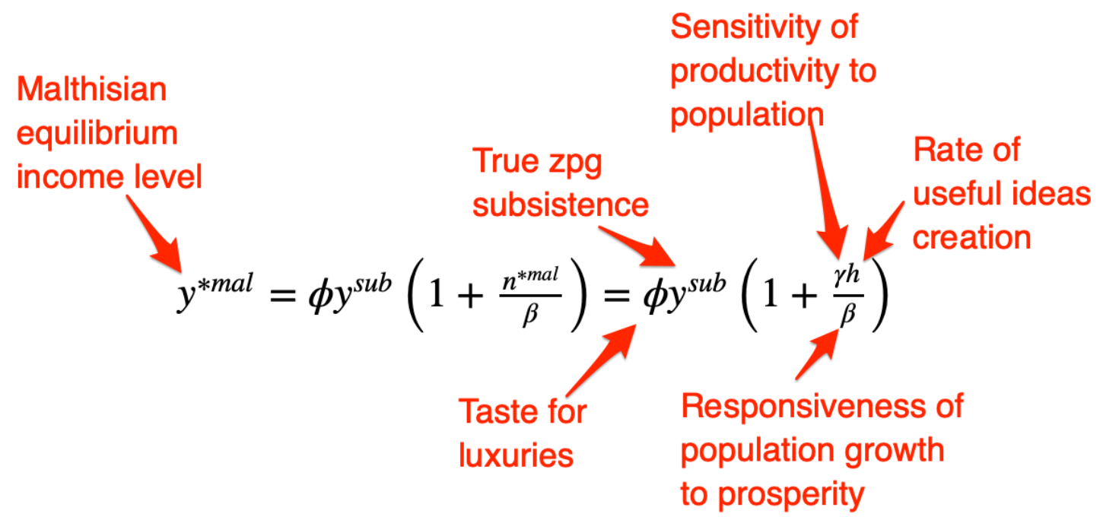
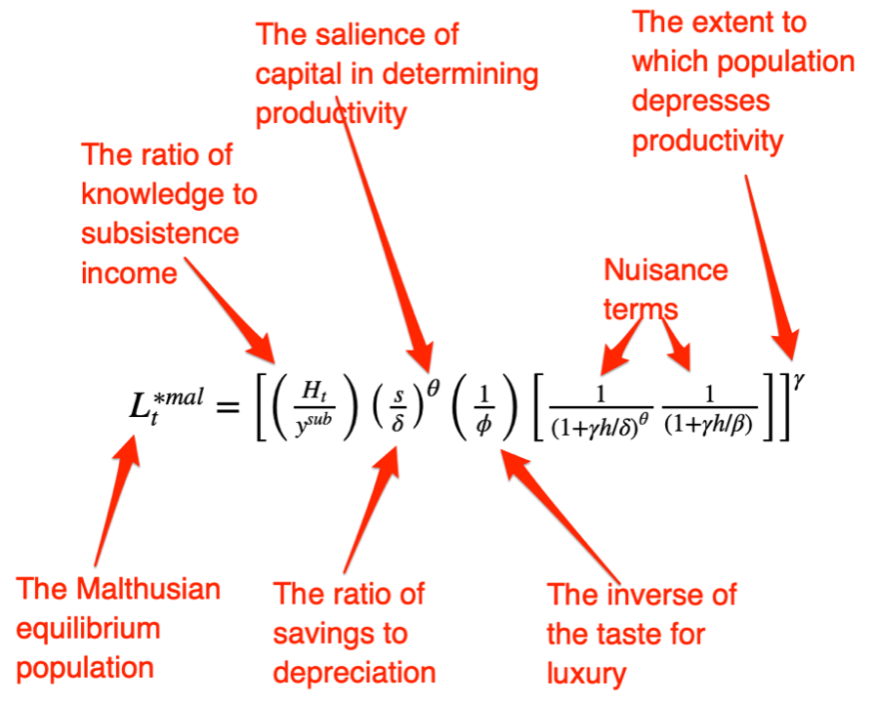
Big Ideas
Takeaways from this lecture:
People were ingenious and inventive back before 1500, yet standards of living did not increase
Populations, however, did
Slowly
We explain this via:
Natural resource scarcity: more heads means smaller farms which offset the productive benefit of better ideas: efficiency of labor growth g = h - n/γ, where h is ideas growth, n is population and labor force growth, and γ is the resource scarcity-pressure parameter.
Population pressure: before the demographic transition, higher standards of living mean faster population growth: n = β(y/(Φy^{sub}) - 1), where Φ is taste for luxuries (inequality! urbanization!), y^{sub} is the income level at which we have zpg on average, and β is the population-responsiveness parameter
Malthusian equilibrium, with efflorescences and declines:

Slide 42
Catch Our Breath…
Ask a couple of questions?
Make a couple of comments?
Any more readings to recommend?

Slide 43
Additional Readings
Gregory Clark (2005): The Condition of the Working Class in England, 1209-2003 <https://delong.typepad.com/files/clark-condition.pdf>...
Ian Morris (2010): Why the West Rules–For Now, chapter 3: Taking the Measure of the Past <https://delong.typepad.com/files/morris-rules-3.pdf>...
Patricia Crone: Pre-Industrial Societies, selections <https://delong.typepad.com/files/crone-pre-selections.pdf>...
C.I. Jones: The Facts of Economic Growth <https://web.stanford.edu/~chadj/facts.pdf>...

